Slide 1
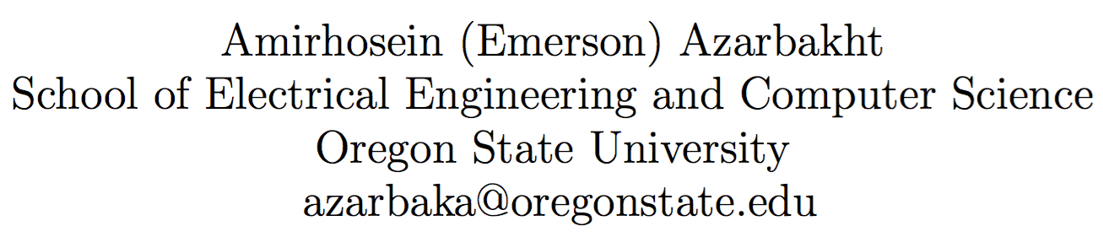
Longitudinal Analysis of Collaboration in Forked Open Source Software Development Projects
Notes:
Good morning, and thank you for being here.
Today we’re gonna talk about open source software.

Slide 2

Great Projects
Assumption: You know what open source is.
Technical quality
Operational health
Survivability
Bus number
Notes:
We all know what open source is,
we’ve all used them, some of us have contributed to them.
Great open source projects share three common attributes;
Technical quality
duh? of course!
Operational health
Ongoing ability to incorporate new code contributions and new developers, and to be responsive to incoming bug reports
Survivability
Ability to exist independently of any individual participant or sponsor; even if all of its founding members were to move on to other things
The bus number: # of people in the project, whom if get hit by a bus, the project will go down, and won’t be able to function and move on. The lower bus #, the better.

Slide 3

Open source is great but not all the time
Not everything works smoothly all the time in open source projects
Problems:
Uncertainty
Industry afraid of "fly-by-night" open source packages & vendors
Notes:
Not everything works smoothly all the time, though.
Problems arise:
Uncertainty?
Will the vendor stick around?
“Industry is just as afraid of "fly-by-night" open source packages as it is of fly-by-night vendors that may not be around tomorrow.”

Slide 4
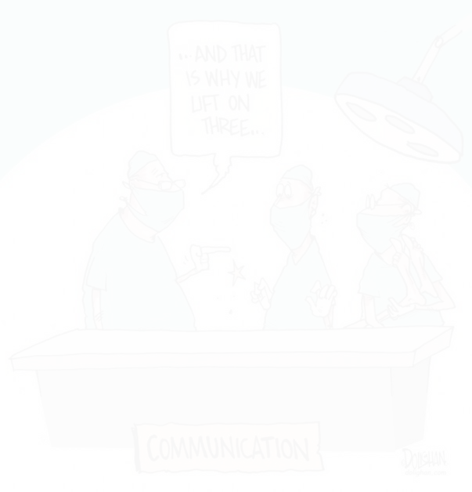

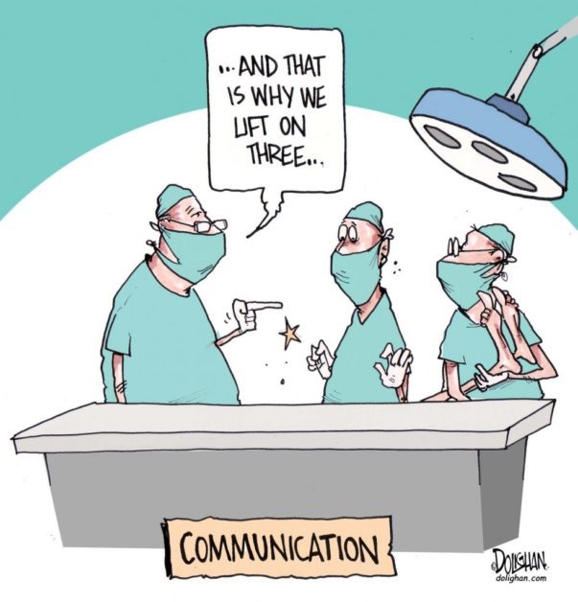
What is this about?
My research focuses on communication, collaboration problems, especially
What triggers forking?
Can we do something to predict when the community started to disintegrate?
Notes:
I researched communication and collaboration problems,
specifically, with regards to forking, i.e. when a software development community starts to disintegrate

Slide 5

Big Picture
Developing complex software systems is complex
Software developers interact
May have same/different goals, communication styles, values
Interactions can be healthy or troubled
Troubled interactions cause troubled communities -> failure
Some of these failures manifest as forks
Failure affects many people; developers and users
Can we save troubled projects?
Notes:
Developing complex software is complex,
many software developers interact
they may have the same goals, or they may have different goals
they may have the same values, or they may have different value,
the same communication styles, or different communication styles
these interactions can be healthy or troubled.
troubled interaction may lead to failure, which manifest themselves as forks
these failures affect many people, including developers, users
the question is, can we save troubled projects?

Slide 6

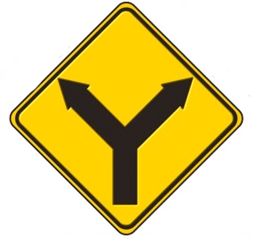
What is forking?
“When a part of a development community (or a third party not related to the project) starts a completely independent line of development based on the source code basis of the project.” (think "fork in the road".)
It can be undesirable:
Dilution of workforce
Flaming & unhealthy dynamics
Redundant work
}
people suffer
The more serious the threat of a fork becomes, the more willing people are to compromise to avoid it.
Notes:
before moving forward, let me define what we mean by forking.
forking can be undesirable, as it results in the

Slide 7

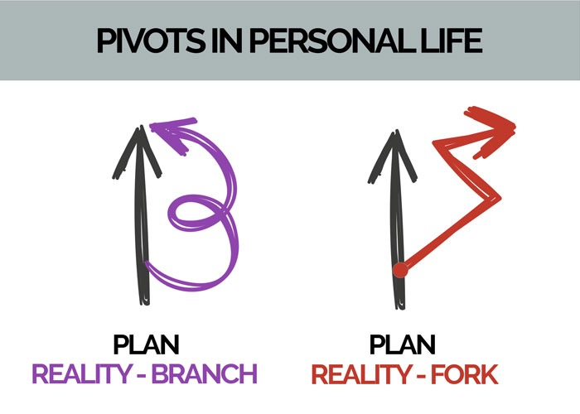

Forking Categories
Communities dissolve or evolve for a variety of different reasons:
Conflict-driven
Destructive
Lead to resentment
Become competitors; “you’re either with us, or against us”
Non-conflict-driven
Developers interested in exploring different functionalities
Not necessarily creating an all-or-nothing type of thing;
Developers participate in multiple communities, as long as it’s a constructive work
Notes:
forking occurs for different reasons
we divide them into conflict-driven and non-conflict-driven forks

Slide 8

Whom are we helping?
Many depend on Open Source
Developer, sponsors, companies, stake-holders can make better-informed decision with the insights of our research
It is important to be affiliated or using a healthy live project, vs. a project that’s in the process of self-destructing
Notes:
This is an important question to look at, because
Many people depend on Open Source
Developer, sponsors, companies, stake-holders can make better-informed decision with the insights of our research
It is important to be affiliated or using a healthy live project, vs. a project that’s in the process of self-destructing

Slide 9
Example: Concerned Developers. Uncertainty
'abalashov@evaristesys.com' '2008-08-04 18:56:57’ '[Kamailio-Devel] [Kamailio-Users] 1.4.0 release plans,\n project matters'
“[…] this seems to be a back-room affair that is still playing out. […] Industry is just as afraid of "fly-by-night" open source packages as it is of fly-by-night vendors that may not be around tomorrow.”
Notes:
let me show you two examples of the concerns developers in open source have.
This is a message sent on the official project discussion board, by a developer who’s experiencing the volatile atmosphere in the project

Slide 10
Example: Concerned Developers Dilution of workforce
'jason.penton@smilecoms.com' '2008-08-04 11:51:25' '[Kamailio-Devel] [Devel] SF.net SVN: opensips:[4568] tags/1.4.0/'
“[…] so now we have [three parallel projects] Surely, this is starting to confuse users and also dilute the number of developers working to ONE common goal. Is this really what we as developers and users want? Is this really what the majority codebase of the product needs? I'd be far happier having all the developers of these 3 projects working on ONE project!”

Slide 11
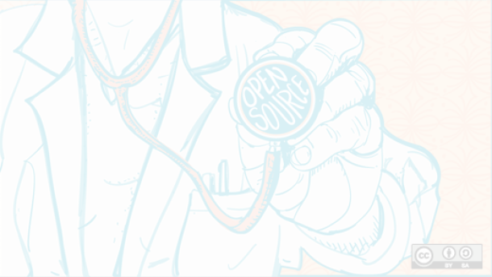
Social Health is Important
Is project likely to fork?
When?
Can we intervene?
Objectively view whether this is a community you want to get involved and invest in.
Notes:
It’d be great if we could predict
Whether our community is likely to fork? or
When they are likely to fork?
So that we can design some sort of intervention, Or,
If you are an industry person, or even an individual contributor, to give you an objective external view of whether this is a community you want to get involved in, or whether you don’t, because getting involved, or using a software requires a level of investment.
For all these reasons, and for all these stake-holders, understanding the social health, and social health evolution of projects is really important.
These are important questions because these are important questions, people, of course, have been looking at this, from a variety of different angles

Slide 12

Related Work
Identifying knowledge brokers [52]
Static Communication patterns [26]
Sustainability [39]
Visual exploration of collaboration [57]
Post-forking porting of new features or bug fixes [7]
Notes:
These are important questions because these are important questions, people, of course, have been looking at this, from a variety of different angles

Slide 13
Related Work
Limitations
Previous research limited to one or two snapshots
How dynamics change over time?
What happens before forking?
Could we have known earlier?
Important gap: the run-up to forks seldom studied
Notes:
there’s been a lot of work, but there’s been things people have not looked at, which we think are important

Slide 14

Research Goals
Can we identify if there is a problem?
Can we do this early enough that we can actually do something about it?
Can we do this using objectively automate-able processes without having to be intimately familiar with the projects?
Notes:
Can we intervene, or evaluate the community health?
We need to figure out, are there key indicators left in the record, that can reliably be used to predict, or to identify problems?
Why these are important: Because if we know these, we could identify unhealthy dynamics and fix them before it’s irreversible.
Can we identify if there’s a problem?
Can we do this early enough that we can actually do something about it?
Can we do this using objectively automate-able processes, where we are not required to be intimately familiar with projects in order to do this?

Slide 15

Data Collection
The first challenge you face:
Finding projects that have gone through various types of forking
Projects survived
Project records survived
Notes:
One of the challenges of studying this that you face is finding projects that have gone through a variety of different types of forking.
We also need for those projects to have survived,
and for the records to have survived.
Unfortunately, that leaves us with a small number of projects.

Slide 16

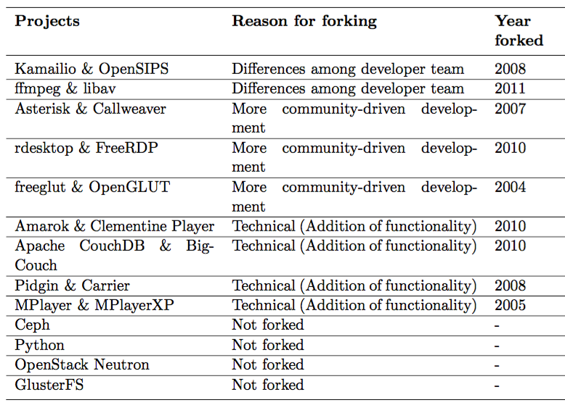
Data Collection Projects
{
Conflict-driven
{
Non-conflict-driven Community-driven
{
Non-conflict-driven Technical
{
Not forked
Notes:
here’s the list of the projects that we could find that satisfy the record-surviving criteria

Slide 17

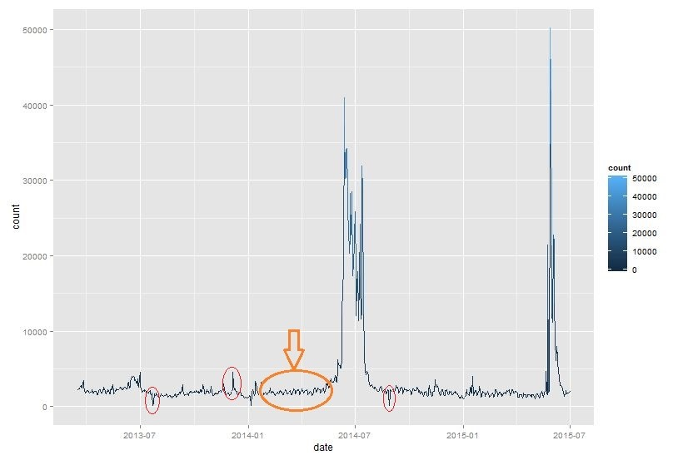
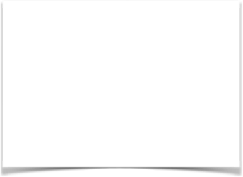
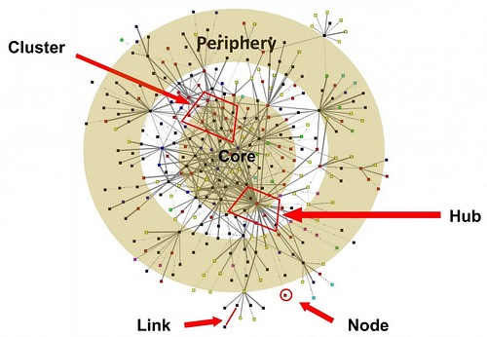
Methodology
Two analyses:
Time series analysis of developers’ communication sentiments
Social network analysis of developers’ interaction graphs
Notes:
We’re dealing with a variety of different data types:
social interactions over time, that both have content and represent relationships between people.
This requires us to do two different types of analysis: Time series analysis and social network analysis

Slide 18
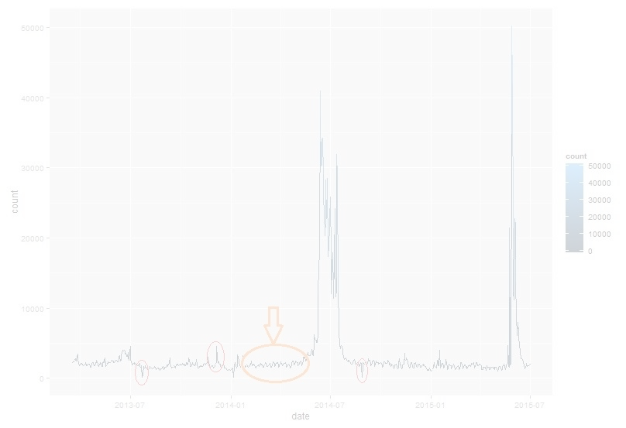
Time series analysis of sentiments
Data: Contents of the messages on the projects’ developers mailing list, for the 10-month run-up to the fork.
(Average 9,166 messages per project)
Anomaly detection as key indicators of problems among the developers, and intervene if needed.
Notes:
For the contents of the messages, we used sentiment analysis, over time.
Here’s why it matters:
The objective was to be able to evaluate the health, and intervene, if needed.
Anomaly detection of the time series analysis may be used by the project stakeholders/investors as key indicators left in the record, that can reliably be used to predict, or to identify problems among the developers, and intervene if need be.

Slide 19
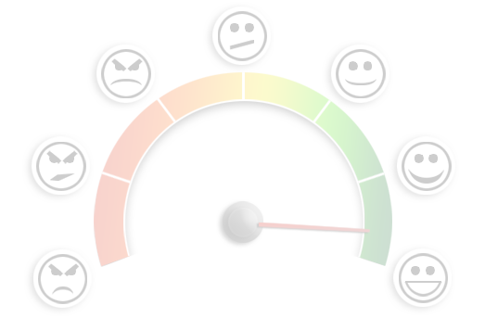
Sentiment Analysis
To determine the attitude of a writer, the overall contextual polarity or emotional reaction to a document, interaction, or event
Used for
“Flame” detection
Bias identification in news sources
Identifying (in)appropriate content for ad placement
Targeting advertising/messages, gauging reactions, etc.

Slide 20
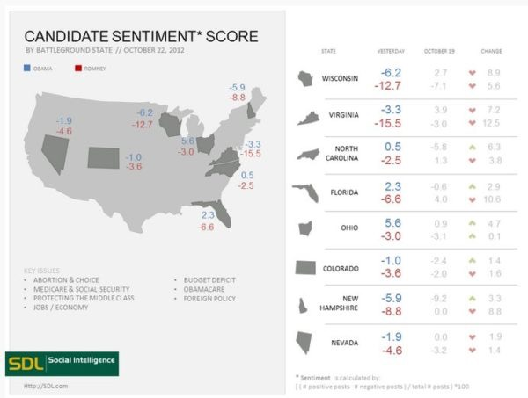
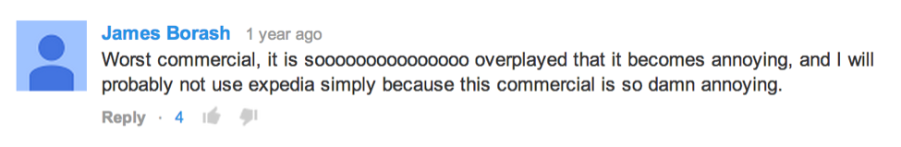
Sentiment Analysis
Examples
The Obama administration used it to gauge public opinion to policy announcements and campaign messages ahead of 2012 election.
Businesses like Expedia use it to understand consumer attitudes and react accordingly.
Notes:
They noticed that there was a steady increase in negative feedback to the music played on the commercial had become incredibly irritating after multiple airings, and consumers were flocking to social media to vent their frustrations.

Slide 21
Sentiment Analysis
Contents of messages sent/received by contributors
A time series of sentiments, to analyze
Notes:
Sentiment analysis algorithm assigns a polarity value between -1 and 1, i.e. negative, positive
Examples: ”Wow, I really like the new light sabers!",
"That book was excellent.",
"R is a fantastic language.",
"The service in this restaurant was miserable.",
"This is neither positive or negative.",
"The waiter forget about my a dessert -- what a poor service!"

Slide 22
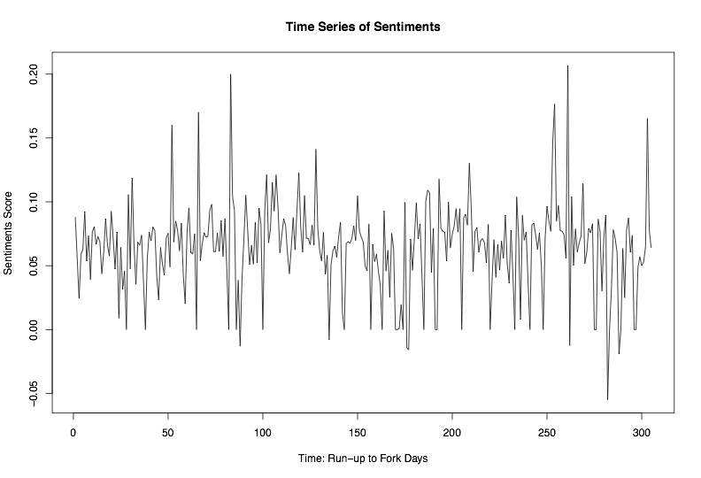
Time Series Analysis of Sentiments

Slide 23
Sentiment Analysis: Time Series Analysis
Used to
To understand the past, and predict the future
Forecasting (predicting inference, a subset of statistical inference). assumes that present trends continue. This assumption cannot be checked empirically, but, when we identify the likely causes for a trend, we can justify the forecasting(extrapolating it) for a few time-steps at least
Anomaly detection
Classification (assigning a time series pattern to a specific category: e.g. gesture recognition of hand movements in sign language videos)
Query by content ~ content-based image retrieval
Notes:
once we had a time series, we could use time series techniques and algorithms.

Slide 24
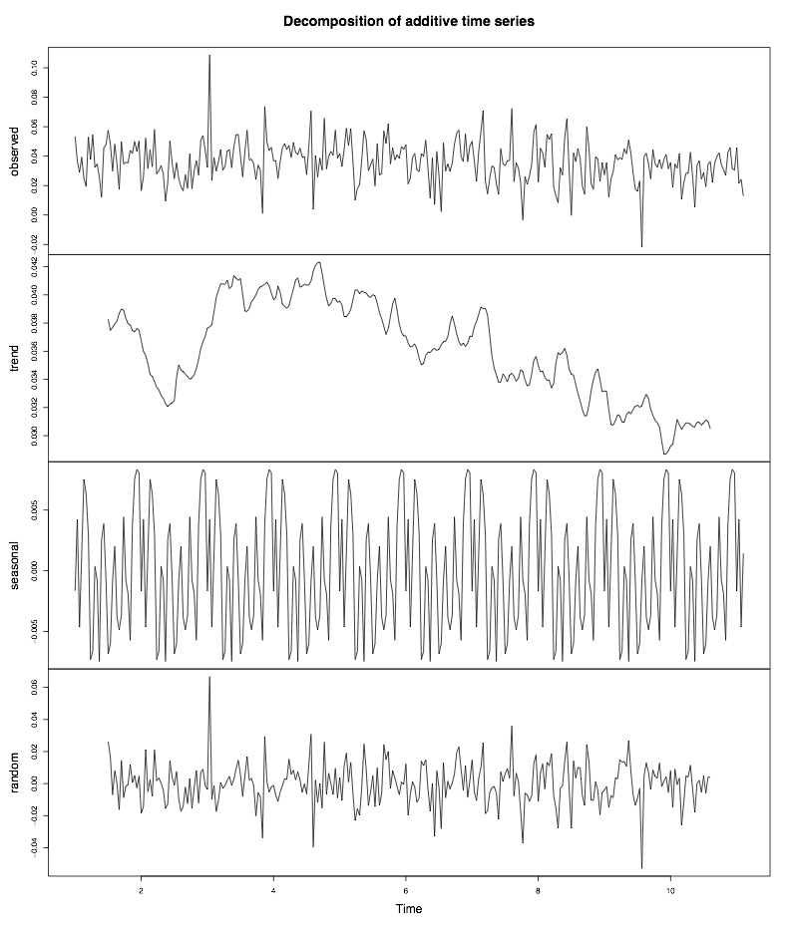
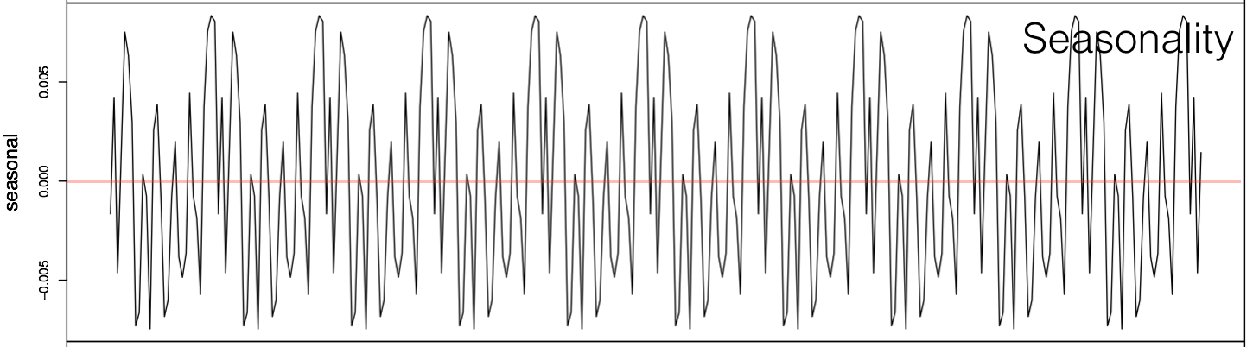
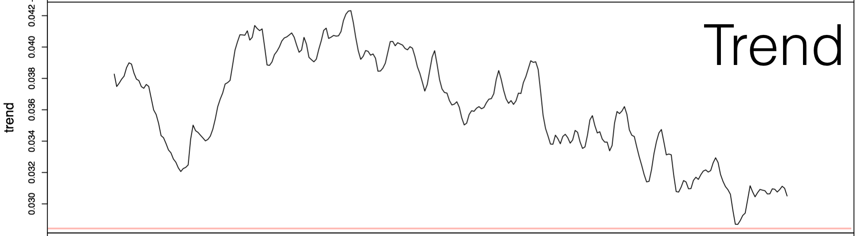
Time Series Analysis of Sentiments
Raw
Trend
{
Seasonality
Most interesting
Residual
Notes:
we can decompose the raw time series, into three components, trend, seasonality, and the residual

Slide 25
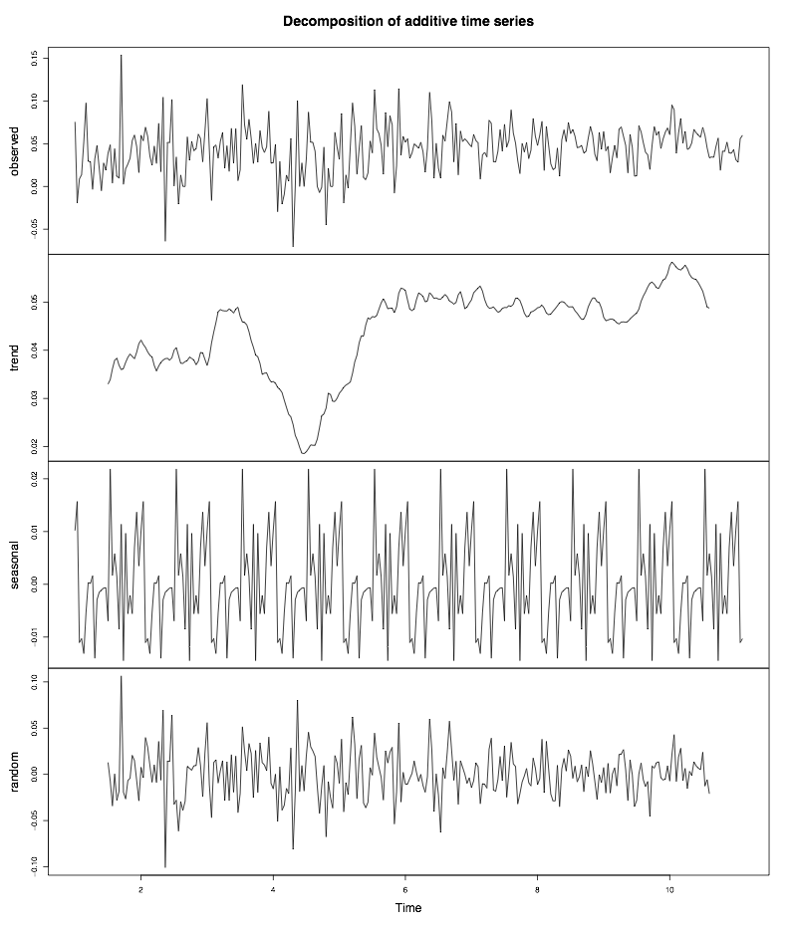
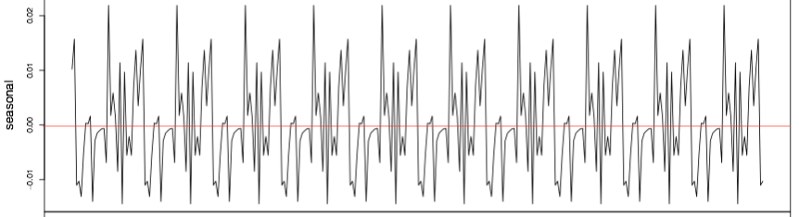
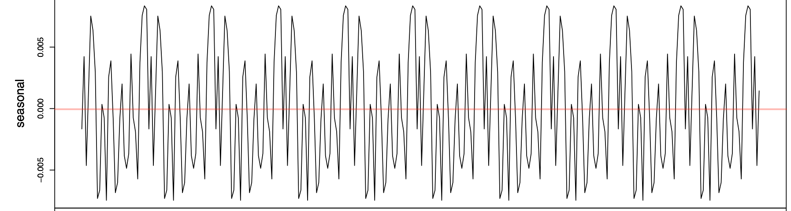
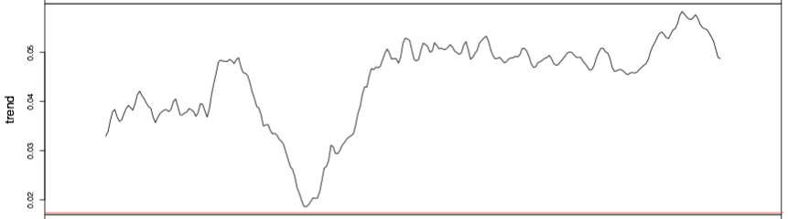
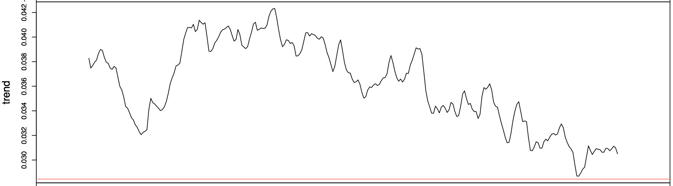
Time Series Analysis of Sentiments
Non-conflict-driven
vs.
Conflict-driven

Slide 26
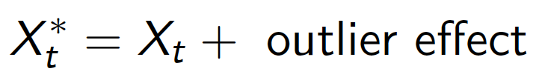
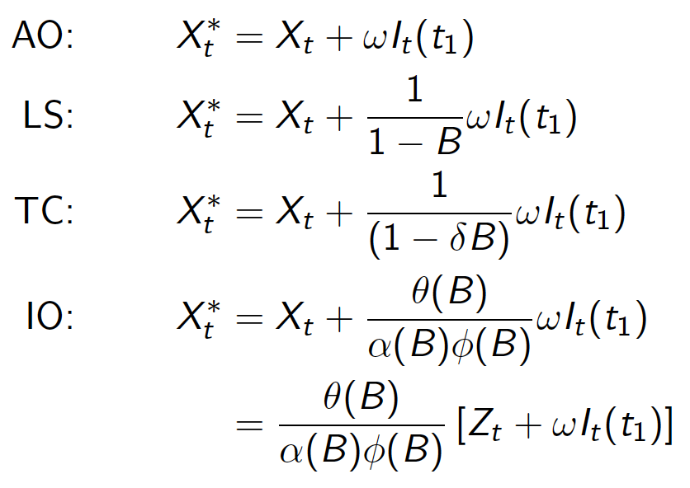
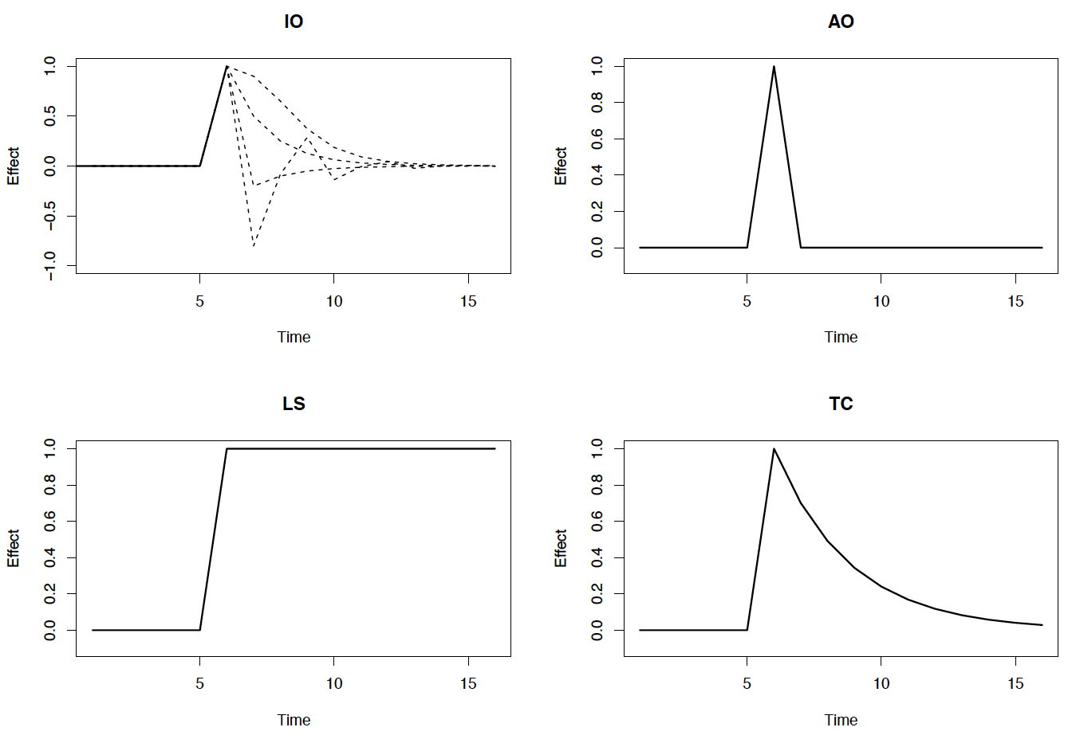
Time Series Analysis of Sentiments: Anomaly Detection
Observed series:
Four models for outlier effect:
Innovational outlier (IO)
Additive outlier (AO)
Level shift (LS)
Temporary change (TC)
Notes:
are there signals in the data that would statistically stand out as anomalies?
What would get flagged as a potentially negative sentiment?

Slide 27
Example of negative sentiments
'abalashov@evaristesys.com' '2008-08-05 02:34:48' '[Kamailio-Devel] [Kamailio-Users] 1.4.0 release plans,\n project matters'
“[…] to the rest of us--those who are not project luminaries--it leaves the situation looking like some absurd, internecine feud replete with tribalism, factionalism, and egotism.”

Slide 28
Example of negative sentiments
'henning.westerholt@1und1.de' '2008-08-04 11:09:15' '[Kamailio-Devel] [Devel] SF.net SVN: opensips:[4568] tags/1.4.0/'
“thanks for the short announcement of the existence of this fork. I was not aware of this, and i’m really disappointed. I think this is not the way to deal with this conflict. I had appreciated to know a little bit earlier of this plans, now i understand the events of the past months on this list and also the board somewhat better.”
Notes:
these are tangible examples of what the algorithm would flag as a negative sentiment,
when you get enough of these, you see a negative trend

Slide 29
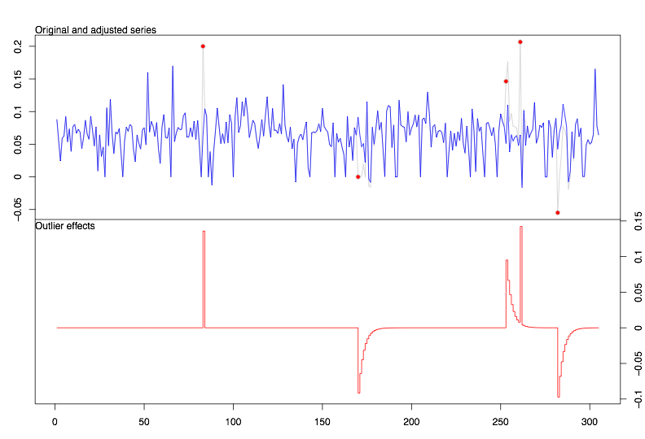

Time Series Analysis of Sentiments: Anomaly Detection
Fork date
Notes:
You can use it to identify outliers, so, the technique works
We do find anomalies close to, but not necessarily on the fork date
Why? forking is not an instantaneous decision, it requires planning, work, there likely is a point of no return, when the words had been said, decisions had been made, but it’s not easy to draw a line saying, here’s where two projects for real exist, and here’s where they are the same.
So, ANOMALY DETECTION WORKS

Slide 30
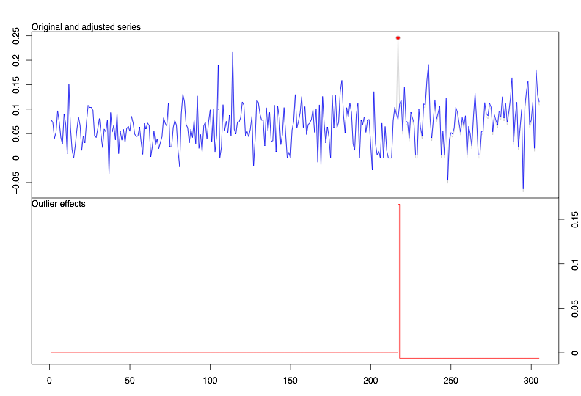
Time Series Analysis of Sentiments: Anomaly Detection
Fork date
Fork date
vs.
Normal, no negative outliers
Anomaly, negative outliers
Non-conflict-driven
Conflict-driven

Slide 31
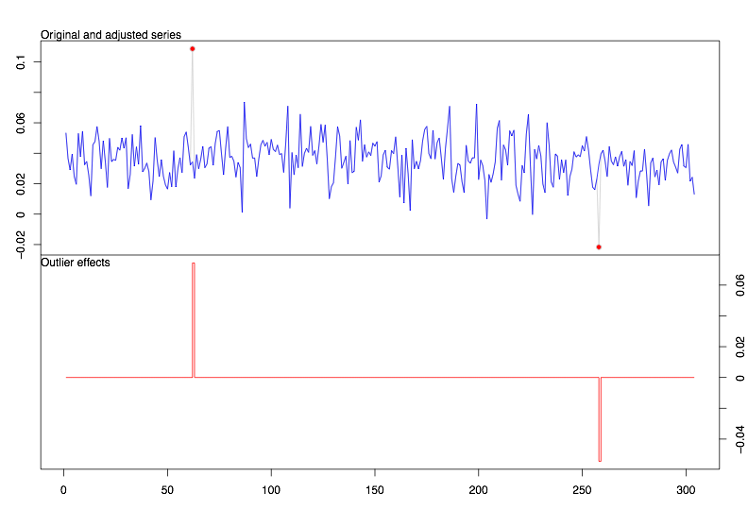
Time Series Analysis of Sentiments: Anomaly Detection: Conflict-driven
Fork date
Fork date
Pre-fork negative outlier anomaly

Slide 32
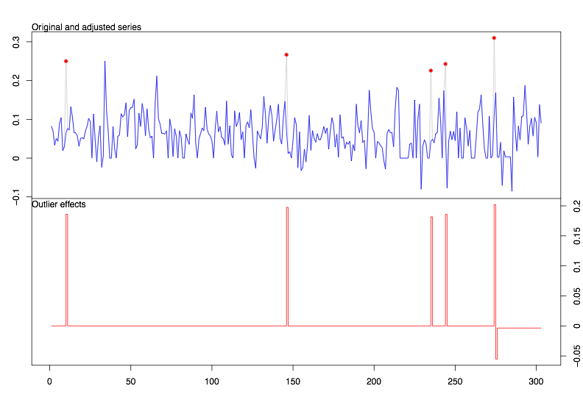
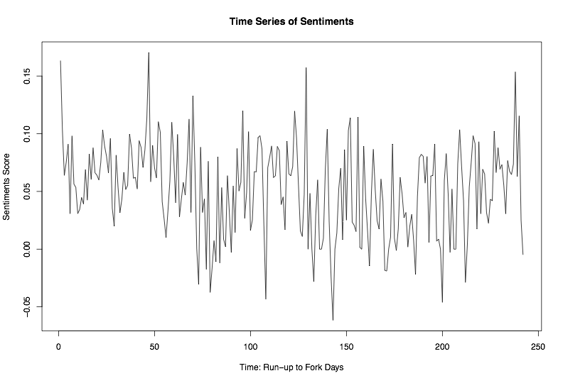
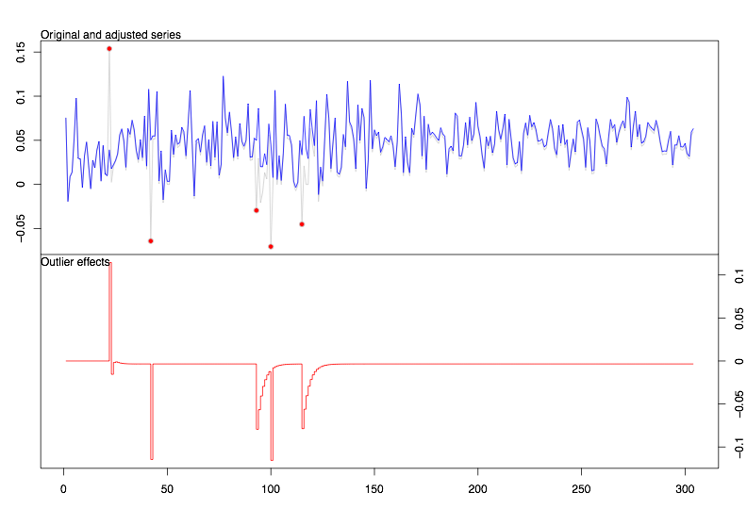
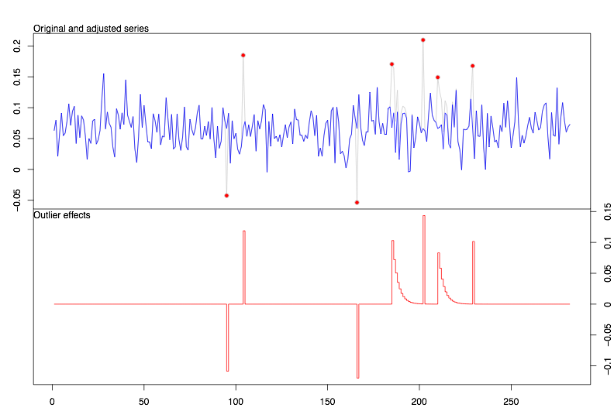
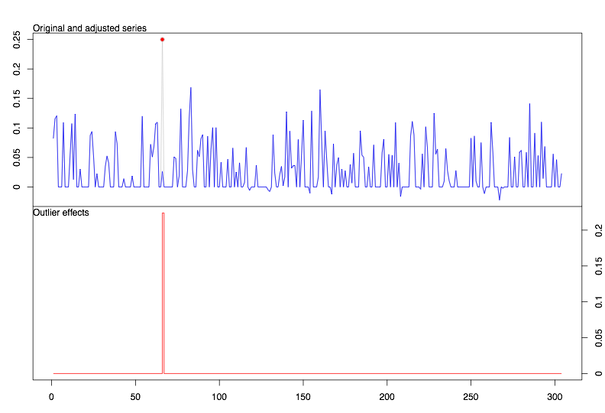
Time Series Analysis of Sentiments: Anomaly Detection: Non-conflict-driven
no outliers detected
No immediate pre-fork negative outlier
Notes:
False positives?
We do get closer, but we can’t necessarily determine when one vs other has occurred.
That’s why we turn to social network analysis, to figure out whether this is a storm in a teacup, or something actually meaningful.
What do these networks look like, who’s involved in these conflicts, and who is not involved in these conflicts.

Slide 33

We got close,
but can’t necessarily determine when one vs. other has occurred.
So we turn to social network analysis, to figure out whether this is a storm in a teacup, or situation needing intervention.
What do these networks look like, who’s involved, what are forces are shaping the community.

Slide 34
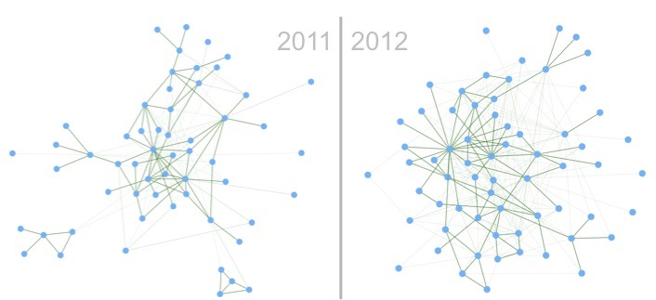
Social network analysis of developers’ communication graphs
Interactions modeled as graphs
Graphs change over time
…

Slide 35
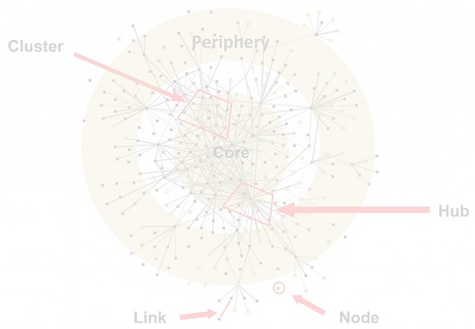
Social network analysis of developers’ communication graphs
Mathematical models
Lead us to estimates of the significance of several parameters’ that affect this longitudinal change.
Notes:
An overview of
What the mathematical models are:
A developer-oriented approach to statistically model the changes a community goes through in the run-up to a fork. The model represented tie formation, tie breakage, and tie maintenance between developers. It uses stochastic estimation methods to estimate several model parameters that capture the variance in the changes the community goes through.
What they lead us to
Estimates of the significance of several parameters on this longitudinal change.

Slide 36
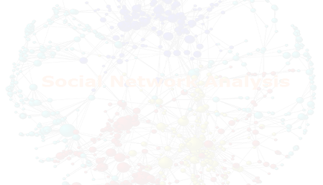


Results
Social network analysis of open source developers’ interaction graphs
 | Negative three-cycles | positive transitive triplets | Out-out degree assortativity | Developer’s source code activity
Conflict-driven | Statistically Significant (*) | Statistically Significant (*) | Statistically Significant (*)
Non-conflict-driven |  |  |  | Statistically Significant (*)

Slide 37
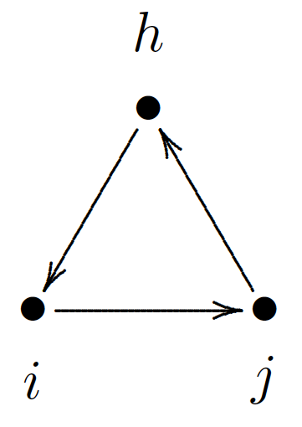
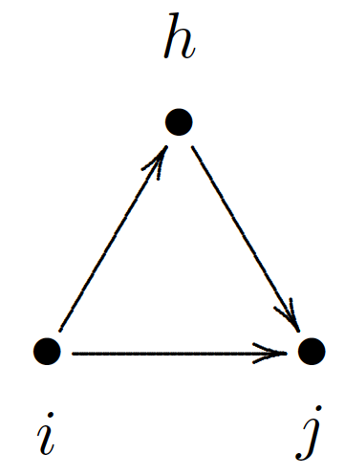
Results
Social network analysis of open source developers’ interaction graphs
Conflict-driven
Local hierarchy (Negative three-cycles (opposite of hierarchy) and positive transitive triplets
Tendency of heavy mailing-list poster developers to be tied to other heavy mailing-list poster developers (Out-out degree assortativity)
Non-conflict-driven
Tendency of heavy code contributors to be tied to other heavy code contributors (Developer’s source code activity)
Notes:
“When comparing two individuals who are equal in other respects except that their source code contribution levels, the odds of them interacting with others compared to no change, is higher for the first individual than the other.”
Here’s my data:
The interaction graphs of the developers that sent and received messages on the projects developers mailing list, for the time period of 10-month run-up to the fork event. And the source code contribution levels of the developers
Here’s what I found:
In conflict-driven forks, (1) the developers maintained a preference for interacting with developers who had similar out-degrees, in contrast to the non-conflict-driven forks, where the developers did not require similar out-degrees. (2) In conflict-driven forks, the interactions were reciprocal, in contrast to the non-conflict-driven forks, where the interactions did not need to be reciprocal to happen. (3) In conflict-driven forks, the more senior developers preferred to interact with other more senior developers, in contrast to the non-conflict-driven forks.
In non-conflict-driven forks, (1) the interactions did not necessarily need to be reciprocal, in contrast to the conflict-driven forks, where the interactions needed to be reciprocal to continue to happen. (2) In non-conflict-driven forks, the developers with high source code contribution levels interacted more with other high source code contributors. (3) In non-conflict-driven forks, high levels of contribution to the source code brings you connections more rapidly, while high levels of contributions to the mailing list is not suggestive of this. This can be interpreted as a sign of meritocracy based on code, rather than talk, which captures a healthy dynamic in these project.
Here’s why it matters:
Estimating the influence of several factors on how developers interact provides indicators of healthy dynamics, such as meritocracy in the project.
Here’s the implications of what I found:
It’s not a great way of measuring up a project, but it’s not a bad way of finding out who in the project deserves credit, who is mostly talk and no action, and whether the project is a meritocracy.

Slide 38
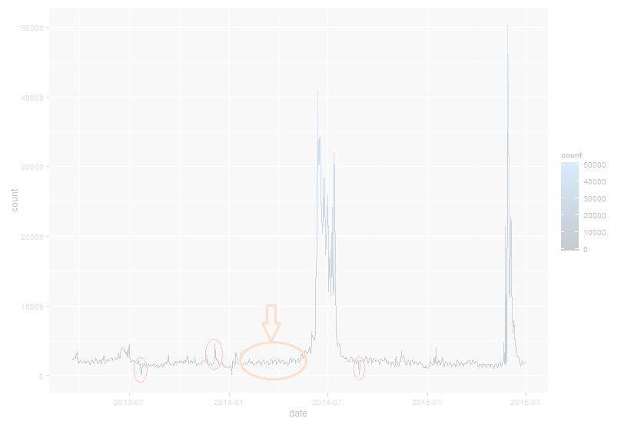
Results
Time series analysis of open source developers’ communication sentiments
Conflict-driven
Negative dips anomalies pre-fork
Non-conflict-driven
Positive spikes anomalies pre-fork.

Slide 39
Results
Time series analysis of open source developers’ communication sentiments
Here’s what I found:
Conflict-driven forks exhibited anomalies; time series analysis of sentiments shows the anomalies occur before the fork event
Non-conflict-driven forks did not suffer from negative pre-fork anomalies
Here’s the implications of what I found
It’s not great, but a good way of caring about an open source project that you rely on.

Slide 40
Discussion
Time series analysis of open source developers’ communication sentiments
Dips don’t always mean a fork happen for sure, because people are not robots, people have social intelligence, they can self-correct.
But, it shows that the community is going through a rough patch, and sometimes things may go completely out of control.
When we detect that we’re heading towards a rough patch, an intervention, or a cooling-off period is probably a good idea. That’s how this could be used to inform decisions.
Same about periodicity; is it a community that went through one rough patch in 15 years, or is it a community that seems to have drama pop up every other week? If it pops up every other week, then chances are sooner or later, the dishes are gonna fly, and someone is gonna pack up their suitcase and move out.

Slide 41
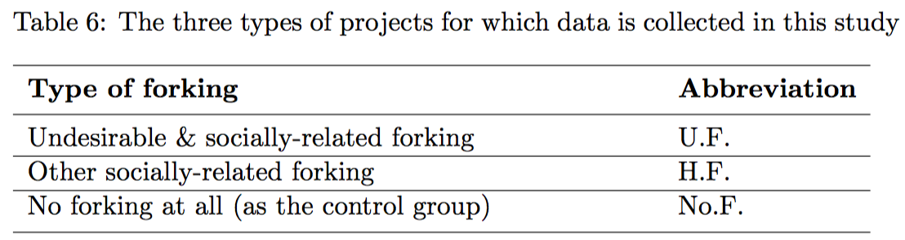
Data Collection
Categories

Slide 42



Summary
Using the two techniques together, we believe, would be a good indicator of project health and project forking, however, this needs to be validated using a bigger dataset, when more data becomes attainable.

Slide 43
Summary
Represented longitudinal dynamics in conflict-driven vs. non-conflict-driven forks
Suggested indicators of unhealthy dynamics to suggest intervention
Detected pre-fork anomalies suggestive of negative communication sentiments
Expressed underlying properties/values of community behavior as model effects and their significance
Good starting point for gaining an understanding of longitudinal change of underlying properties of an open source project community. (e.g. Github add-on)

Slide 44

Future Work
More projects needed
Apply into project management systems, e.g. Github integrate, to see if reflection changes community dynamics, or help make smarter decisions
Does more transparency result in project self-regulation?

Slide 45

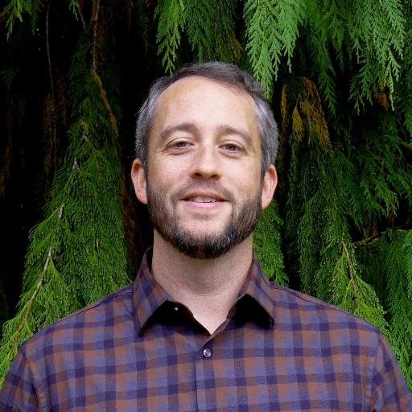
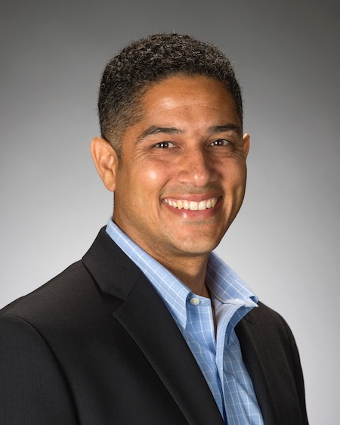
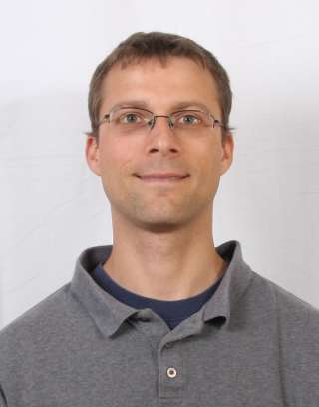
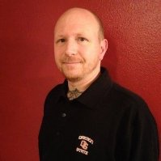
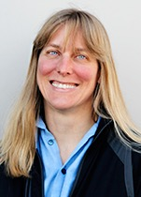

Acknowledgements
Prof. Carlos Jensen
Prof. Drew Gerkey
Prof. Ron Metoyer
Prof. Chris Scaffidi
Derric Jacobs
Prof. Cindy Grimm
Prof. Yelda Turkan

Slide 46
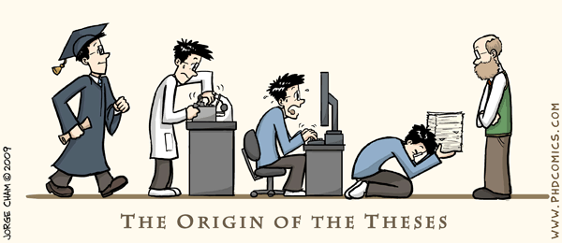

Slide 47
Back up slides follow

Slide 48
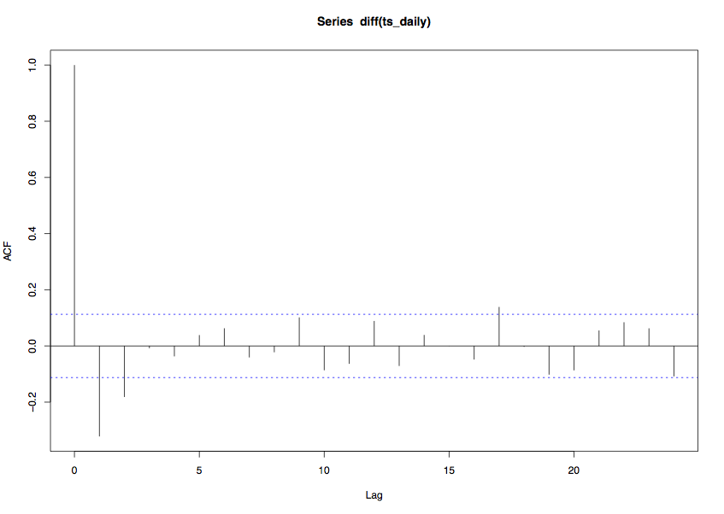
Time Series Analysis of Sentiments: ACF
Notes:
we can decompose the raw time series, into three components, trend, seasonality, and the residual

Slide 49
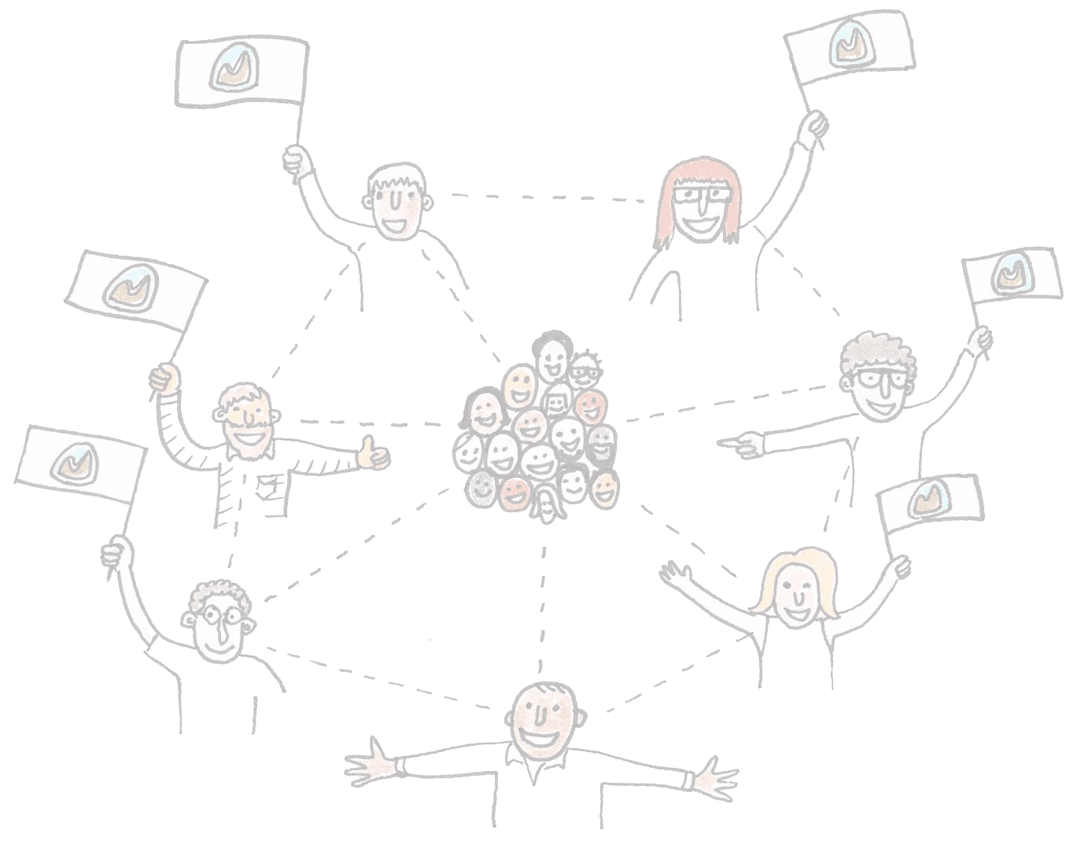
Developer Interactions
Occurs through mailing lists, IRC lines, comments, bug tracking system: This is where people talk, this is where communities form. Some of these are more important than others, for our analysis.
We primarily focus on mailing lists; Mailing List is the official record; this is where the important stuff gets discussed. This is the biggest public forum. You could have minor blow-ups in other parts, and that’s okay, if it’s important, it will migrate to the mailing list. Will be captured in the mailing list.
IRC: Not everyone participates, there’s no record, it’s ephemeral
Git logs: not everyone reads them, they are typically focused on what the code is at that point
Bug tracking system: not everyone reads them, they are typically focused on what the code is at that point

Slide 50
Economics that Drive
Open Source
A company often needs a particular piece of software to be maintained and developed, and yet does not need a monopoly on that software.
Example: everyone needs a web server software, but no one needs to own. Why not share the burden of maintenance?

Slide 51
Business Models
Support-ware
Software is free, support is not
Product-ware
Software is free, the device it runs on is not
Cloud-ware
Software is free, but only runs on cloud. Pay us for use/resources
Project-ware
Base software is free, pay us to customize it
Hybrid-ware
Proprietary add-ons or premium features
Dual License
Commercial us vs. non-profit & education uses
Consortium-ware
Everyone commits resources for common good. Services (per use)
Ad-Ware
All hail Google the great and powerful
Donation-ware
Click to contribute

Slide 52
Governance Structures
Benevolent Dictators
Final decision-making authority rests with one person, who, by virtue of personality and experience, is expected to use it wisely. Reluctance to make decisions by fiat is a trait shared by almost all successful benevolent dictators; and one of the reasons they manage to keep the role.
Consensus-based Democracy
As projects get older, they move away from benevolent dictatorship, toward group-based governance.
Consensus simply means an agreement that everyone is willing to live with. A group has reached consensus on a given question when someone proposes that consensus has been reached and no one contradicts the assertion.

Slide 53
Why[some] Corporations Support Open Source?
Sharing the burden
Ensuring maintenance of infrastructure
when a company sells services which depend on FOSS
Establishing a standard
releasing an open source implementation of that standard
Creating an ecosystem
in which they are more likely to flourish
Supporting hardware sales
having high-quality free software to run on hardware is important to customers
Undermining a competitor
Eating away at a competitor's market share
Marketing
Proprietary relicensing

Slide 54
Undesirable forks = ?
Undesirable forks: Perceived as bad forks, that affects the developer community and users negatively, and would’ve been avoided if possible.
Socially-related forks: Could have left traces in the developers’ interactions data.
forked
Socially-related
Undesirable

Slide 55

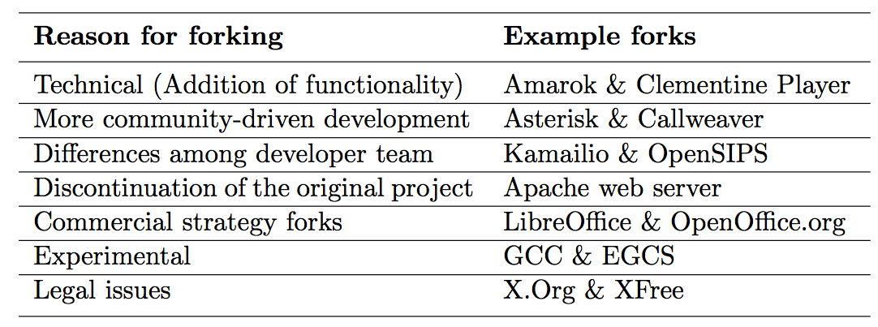
Why Projects Fork?
{
H.F.
{
Socially-related
U.F.

Slide 56
Sentiment Analysis: Time Series Analysis
Patterns
Trend: a non-periodic systematic change in a TS: a long-term change in the ‘mean’.
Can be modeled simply by a linear increase or decrease. (only if it's deterministic ~ it's non-stochastic).
Stochastic trend: seems to change direction at unpredictable times rather than displaying a consistent pattern (e.g. like the air passenger series); inexplicable changes in direction
Seasonal variation: a repeating pattern within a fixed period (e.g. each year)
Cycles: a non-fixed-period cycle (without a fixed period). Example: El-Nino
Residual: Most interesting component for analysis.

Slide 57










Time Series of Sentiments

Slide 58







Time Series Analysis of Sentiments
{
{
Conflict-driven
Non-conflict-driven

Slide 59



Time Series Analysis of Sentiments
{
No Fork

Slide 60



Time Series Analysis of Sentiments: Anomaly Detection: No.F.
Outlier, in positive direction,
in contrast to negative outlier in conflict-driven.
No fork

Slide 61
Statistical Model
Longitudinal
Developer-oriented:
Developers choose whom to talk to
Likelihood of forming ties, maintaining ties, …
Stochastic
Developers behave to optimize an objective function; included our covariates
Assume observed graphs as outcomes of a continuous-time Markov process
Estimated

Slide 62
Social network analysis of developers’ communication graphs
An overview of
What the mathematical models are:
A developer-oriented approach to statistically model the changes a community goes through in the run-up to a fork. The model represented tie formation, tie breakage, and tie maintenance between developers. It uses stochastic estimation methods to estimate several model parameters that capture the variance in the changes the community goes through.
What they lead us to
Estimates of the significance of several parameters on this longitudinal change.

Slide 63

Social network analysis of developers’ communication graphs
{
Statistical Modeling

Slide 64
Results
Social network analysis of open source developers’ interaction graphs
Here’s my data:
The interaction graphs of the developers that sent and received messages on the projects developers mailing list, for the time period of 10-month run-up to the fork event. And the source code contribution levels of the developers
Here’s what I found:
TABLE
In conflict-driven forks, (1) the developers maintained a preference for interacting with developers who had similar out-degrees, in contrast to the non-conflict-driven forks, where the developers did not require similar out-degrees. (2) In conflict-driven forks, the interactions were reciprocal, in contrast to the non-conflict-driven forks, where the interactions did not need to be reciprocal to happen. (3) In conflict-driven forks, the more senior developers preferred to interact with other more senior developers, in contrast to the non-conflict-driven forks.
In non-conflict-driven forks, (1) the interactions did not necessarily need to be reciprocal, in contrast to the conflict-driven forks, where the interactions needed to be reciprocal to continue to happen. (2) In non-conflict-driven forks, the developers with high source code contribution levels interacted more with other high source code contributors. (3) In non-conflict-driven forks, high levels of contribution to the source code brings you connections more rapidly, while high levels of contributions to the mailing list is not suggestive of this. This can be interpreted as a sign of meritocracy based on code, rather than talk, which captures a healthy dynamic in these project.
Here’s why it matters:
Estimating the influence of several factors on how developers interact provides indicators of healthy dynamics, such as meritocracy in the project.
Here’s the implications of what I found:
It’s not a great way of measuring up a project, but it’s not a bad way of finding out who in the project deserves credit, who is mostly talk and no action, and whether the project is a meritocracy.
Notes:
Dips don’t always mean a fork happen for sure, because people are not robots, people have social intelligence, they can self-correct.
But, it shows that the community is going through a rough patch, and sometimes things may go completely out of control.
When we detect that we’re heading towards a rough patch, an intervention, or a cooling-off period is probably a good idea. That’s how this could be used to inform decisions.
Same about periodicity; is it a community that went through one rough patch in 15 years, or is it a community that seems to have drama pop up every other week? If it pops up every other week, then chances are sooner or later, the dishes are gonna fly, and someone is gonna pack up their suitcase and move out.

Slide 65
Results
Social network analysis of open source developers’ interaction graphs
Here’s my data:
The interaction graphs of the developers that sent and received messages on the projects developers mailing list, for the time period of 10-month run-up to the fork event. And the source code contribution levels of the developers
Here’s what I found:
In conflict-driven forks, (1) the developers maintained a preference for interacting with developers who had similar out-degrees, in contrast to the non-conflict-driven forks, where the developers did not require similar out-degrees. (2) In conflict-driven forks, the interactions were reciprocal, in contrast to the non-conflict-driven forks, where the interactions did not need to be reciprocal to happen. (3) In conflict-driven forks, the more senior developers preferred to interact with other more senior developers, in contrast to the non-conflict-driven forks.
In non-conflict-driven forks, (1) the interactions did not necessarily need to be reciprocal, in contrast to the conflict-driven forks, where the interactions needed to be reciprocal to continue to happen. (2) In non-conflict-driven forks, the developers with high source code contribution levels interacted more with other high source code contributors. (3) In non-conflict-driven forks, high levels of contribution to the source code brings you connections more rapidly, while high levels of contributions to the mailing list is not suggestive of this. This can be interpreted as a sign of meritocracy based on code, rather than talk, which captures a healthy dynamic in these project.
Here’s why it matters:
Estimating the influence of several factors on how developers interact provides indicators of healthy dynamics, such as meritocracy in the project.
Here’s the implications of what I found:
It’s not a great way of measuring up a project, but it’s not a bad way of finding out who in the project deserves credit, who is mostly talk and no action, and whether the project is a meritocracy.
Notes:
Dips don’t always mean a fork happen for sure, because people are not robots, people have social intelligence, they can self-correct.
But, it shows that the community is going through a rough patch, and sometimes things may go completely out of control.
When we detect that we’re heading towards a rough patch, an intervention, or a cooling-off period is probably a good idea. That’s how this could be used to inform decisions.
Same about periodicity; is it a community that went through one rough patch in 15 years, or is it a community that seems to have drama pop up every other week? If it pops up every other week, then chances are sooner or later, the dishes are gonna fly, and someone is gonna pack up their suitcase and move out.

Slide 66
Social network analysis of developers’ communication graphs

Slide 67


Statistical Model
Longitudinal change = a series of mini-steps
To model graph evolution from to ,
and so on, we treat the dynamics as the results of a series of small atomic changes (mini-steps)

Slide 68




Statistical Model
Mathematical notation
Data: repeated observations on a graph with developers
Representation: Directed graphs with adjacency matrices for
where i and j range from
shows whether at time t, there exists a tie from to (value 1) or not (value 0).

Slide 69
Statistical Model Mini-steps
Developer whose tie is changing, has control over the change
The graph changes one tie at a time (1 mini-step)
The moment of change & the kind of change depends on observed covariates and the graph structure
The moment of change is stochastically determined by the rate function
The particular kind of change is determined by the objective function

Slide 70
Statistical Model Rate Function
The rate function λ_{i}(x) for developer i is the rate at which developer i’s outgoing connection changes occur.
It models how frequently the developers make mini-steps.

Slide 71

Statistical Model Objective function
The objective function f_{i}(s) for developer i is the value attached to the network configuration x.
Functions s_{ik}(x) are the effects we define. Parameters β = (β₁, ..., β_{L}) is to be estimated.
Idea: Given the opportunity to make a change in his out-going tie variables (X_{i1},...,X_{ig}), developer i selects the change that gives the greatest increase in the objective function.

Slide 72
Statistical Model
Simulation and Estimation
Using Method of Moments (MoM)
Equate the observed sample statistics to the theoretical population statistics and solve the equation to find the coefficients
Markov Chain Monte Carlo (MCMC) estimation
Simulate the network evolution, and estimate the model based on the simulations
We fitted/have a model

